Slide 1
Kinetic Origami
Making Paper Folding Move

Slide 2

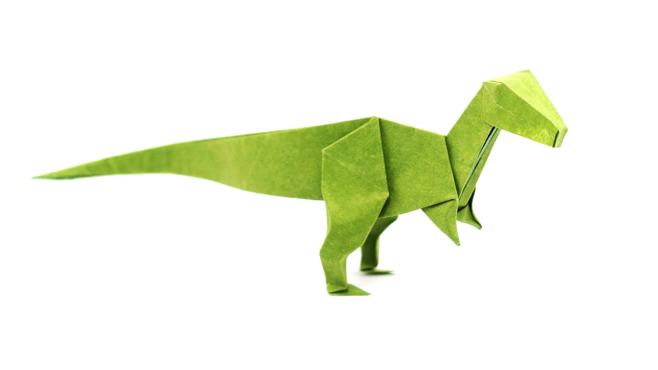
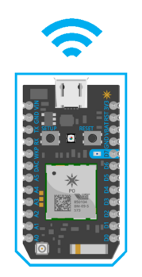
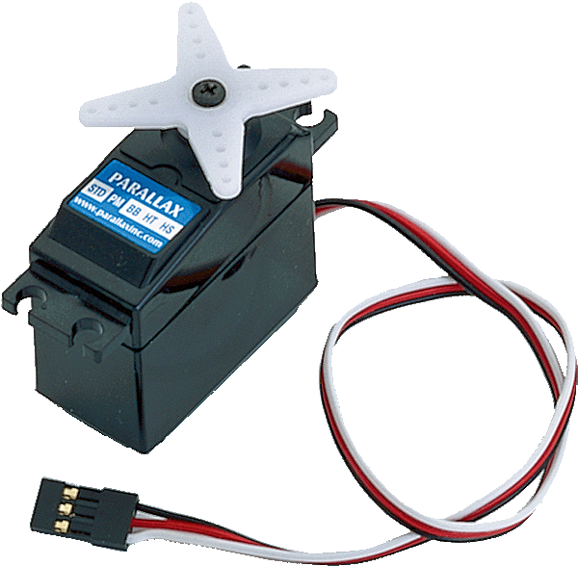

TL;DR
#IoT Recipe
+
+
+

Slide 3
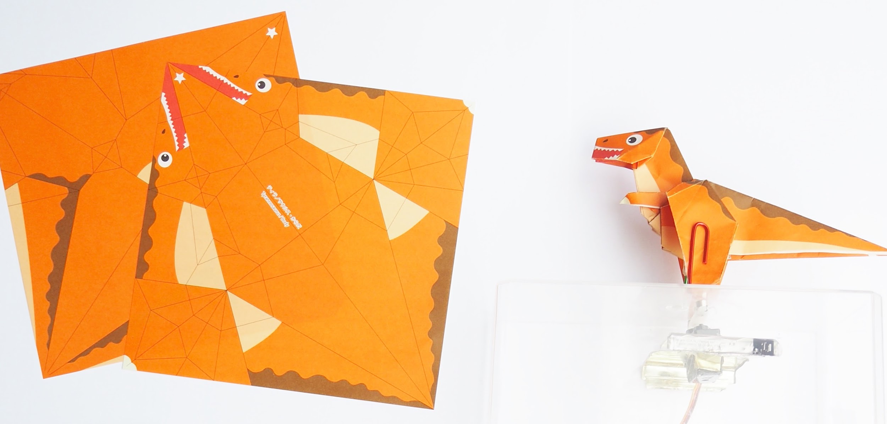
Origami
Get physical

Slide 4

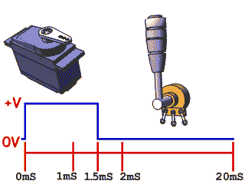
Movement
https://12geeks.com/shop/circuit-components/motors/emax-9g-es08a-high-sensitive-mini-servo.html

Slide 5

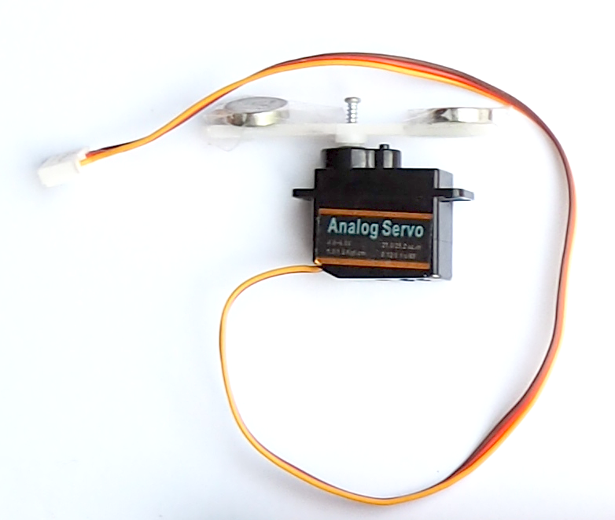


Magnets & Miracles

Slide 6
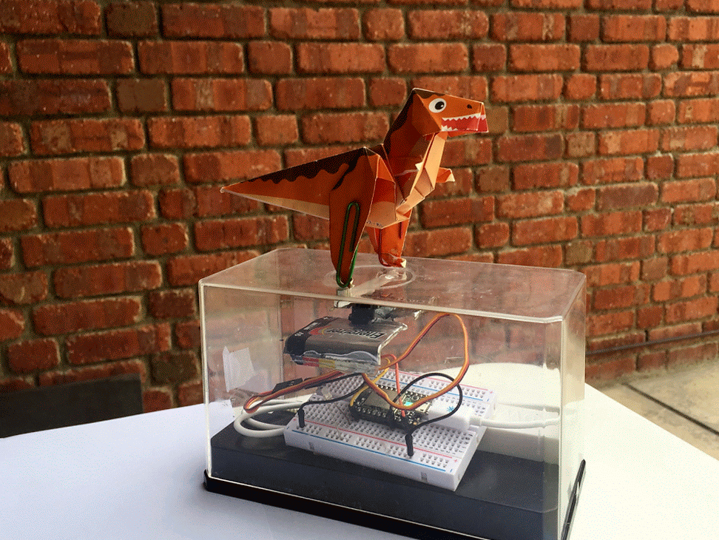

Slide 7
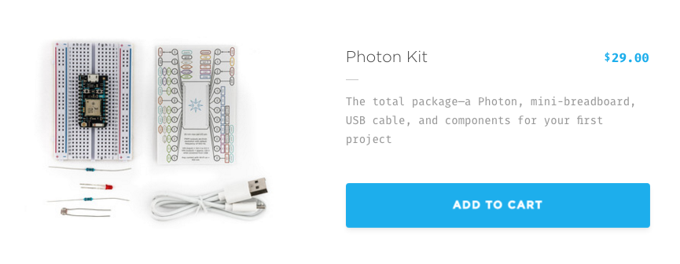
Particle
https://12geeks.com/shop/spark-photon-with-breadboard-headers.html

Slide 8
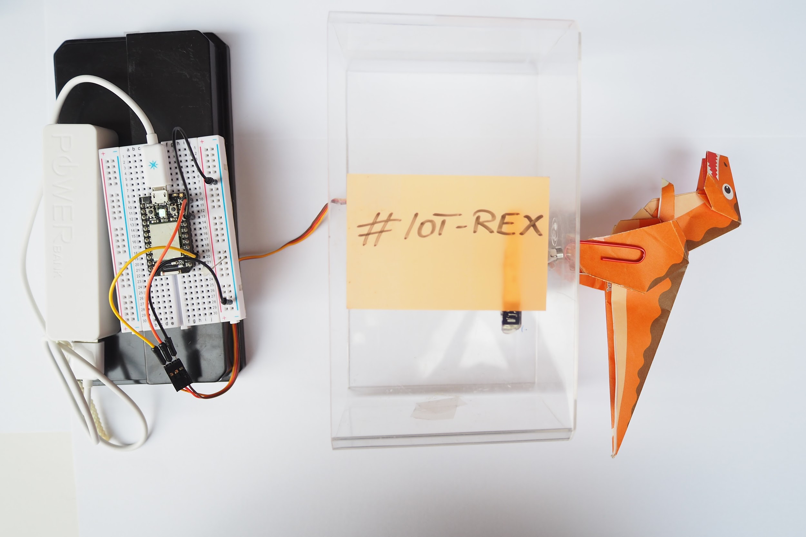

Slide 9
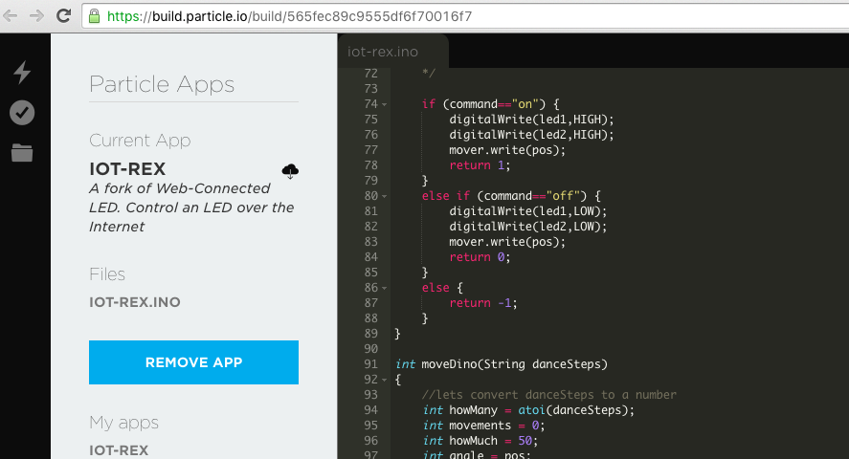
Scary Code
Notes:
// -----------------------------------
// Controlling T-REX over the Internet
// -----------------------------------
// First, let's create our "shorthand" for the pins
// Same as in the Blink an LED example:
// led1 is wired to D0, led2 is D7
// Servo is wired to D1
// 54ff70066678574948440567 Device ID
int led1 = D0;
int led2 = D7;
//Npw let's make things move using your servo motor
Servo mover;
int pos = 30;
// Last time, we only needed to declare pins in the setup function.
// This time, we are also going to register our Spark function
void setup()
{
// Here's the pin configuration, same as last time
pinMode(led1, OUTPUT);
pinMode(led2, OUTPUT);
mover.attach(D1);
digitalWrite(led1, HIGH);
digitalWrite(led2, HIGH);
// We are also going to declare a Spark.function so that we can turn the LED on and off from the cloud.
Particle.function("led",ledToggle);
// This is saying that when we ask the cloud for the function "led", it will employ the function ledToggle() from this app.
//Similarly, we declare a Spark.function to control the Movement of the servo
Particle.function("dance",moveDino);
//debug
Particle.function("servo",setHome);
// For good measure, let's also make sure both LEDs are off when we start:
digitalWrite(led1, LOW);
digitalWrite(led2, LOW);
//and reset the servo position to "home"
mover.write(pos);
}
// Last time, we wanted to continously blink the LED on and off
// Since we're waiting for input through the cloud this time,
// we don't actually need to put anything in the loop
void loop()
{
// Nothing to do here
}
// We're going to have a super cool function now that gets called when a matching API request is sent
// This is the ledToggle function we registered to the "led" Spark.function earlier.
int ledToggle(String command) {
/* Spark.functions always take a string as an argument and return an integer.
Since we can pass a string, it means that we can give the program commands on how the function should be used.
In this case, telling the function "on" will turn the LED on and telling it "off" will turn the LED off.
Then, the function returns a value to us to let us know what happened.
In this case, it will return 1 for the LEDs turning on, 0 for the LEDs turning off,
and -1 if we received a totally bogus command that didn't do anything to the LEDs.
*/
if (command=="on") {
digitalWrite(led1,HIGH);
digitalWrite(led2,HIGH);
mover.write(pos);
return 1;
}
else if (command=="off") {
digitalWrite(led1,LOW);
digitalWrite(led2,LOW);
mover.write(pos);
return 0;
}
else {
return -1;
}
}
int moveDino(String danceSteps)
{
//lets convert danceSteps to a number
int howMany = atoi(danceSteps);
int movements = 0;
int howMuch = 50;
int angle = pos;
for(movements = 0; movements < howMany; movements+=1)
{
digitalWrite(led1,HIGH);
for(angle = pos; angle < pos + howMuch; angle += 1) // goes from home degrees to howMuch degrees
{ // in steps of 1 degree
mover.write(angle); // tell servo to go to position in variable 'angle'
delay(4); // waits 15ms for the servo to reach the position
}
for(angle = pos + howMuch; angle>=pos; angle-=1) // goes from 180 degrees to 0 degrees
{
mover.write(angle); // tell servo to go to position in variable 'pos'
delay(4); // waits 15ms for the servo to reach the position
}
delay(20);
digitalWrite(led1,LOW);
}
}
int setHome(String newPos)
{
pos = atoi(newPos);
mover.write(pos);
return pos;
}

Slide 10
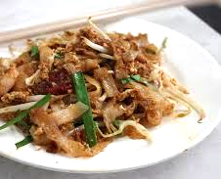
Char kway teow code

Slide 11
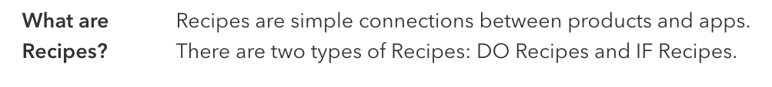
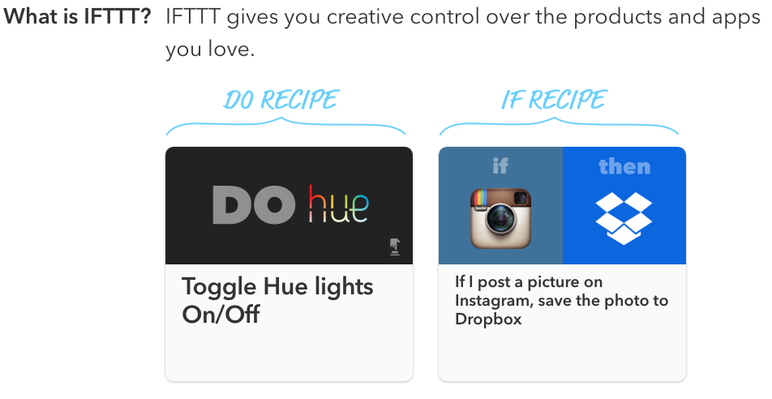
IFTTT Recipes

Slide 12

IF
#danceDinoDance

Slide 13
Get cooking. DEMO [IF]

Slide 14
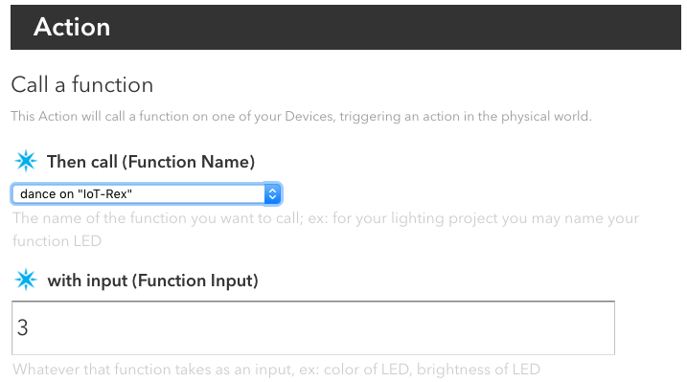
DO

Slide 15
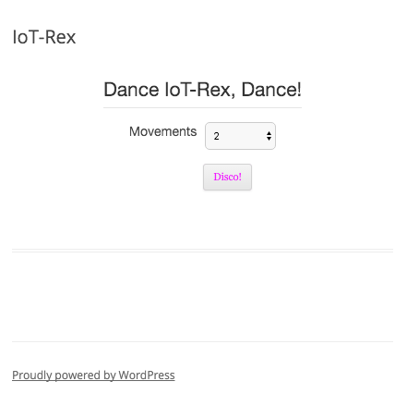
Blog Post
http://tusi.sg/iot-rex/

Slide 16
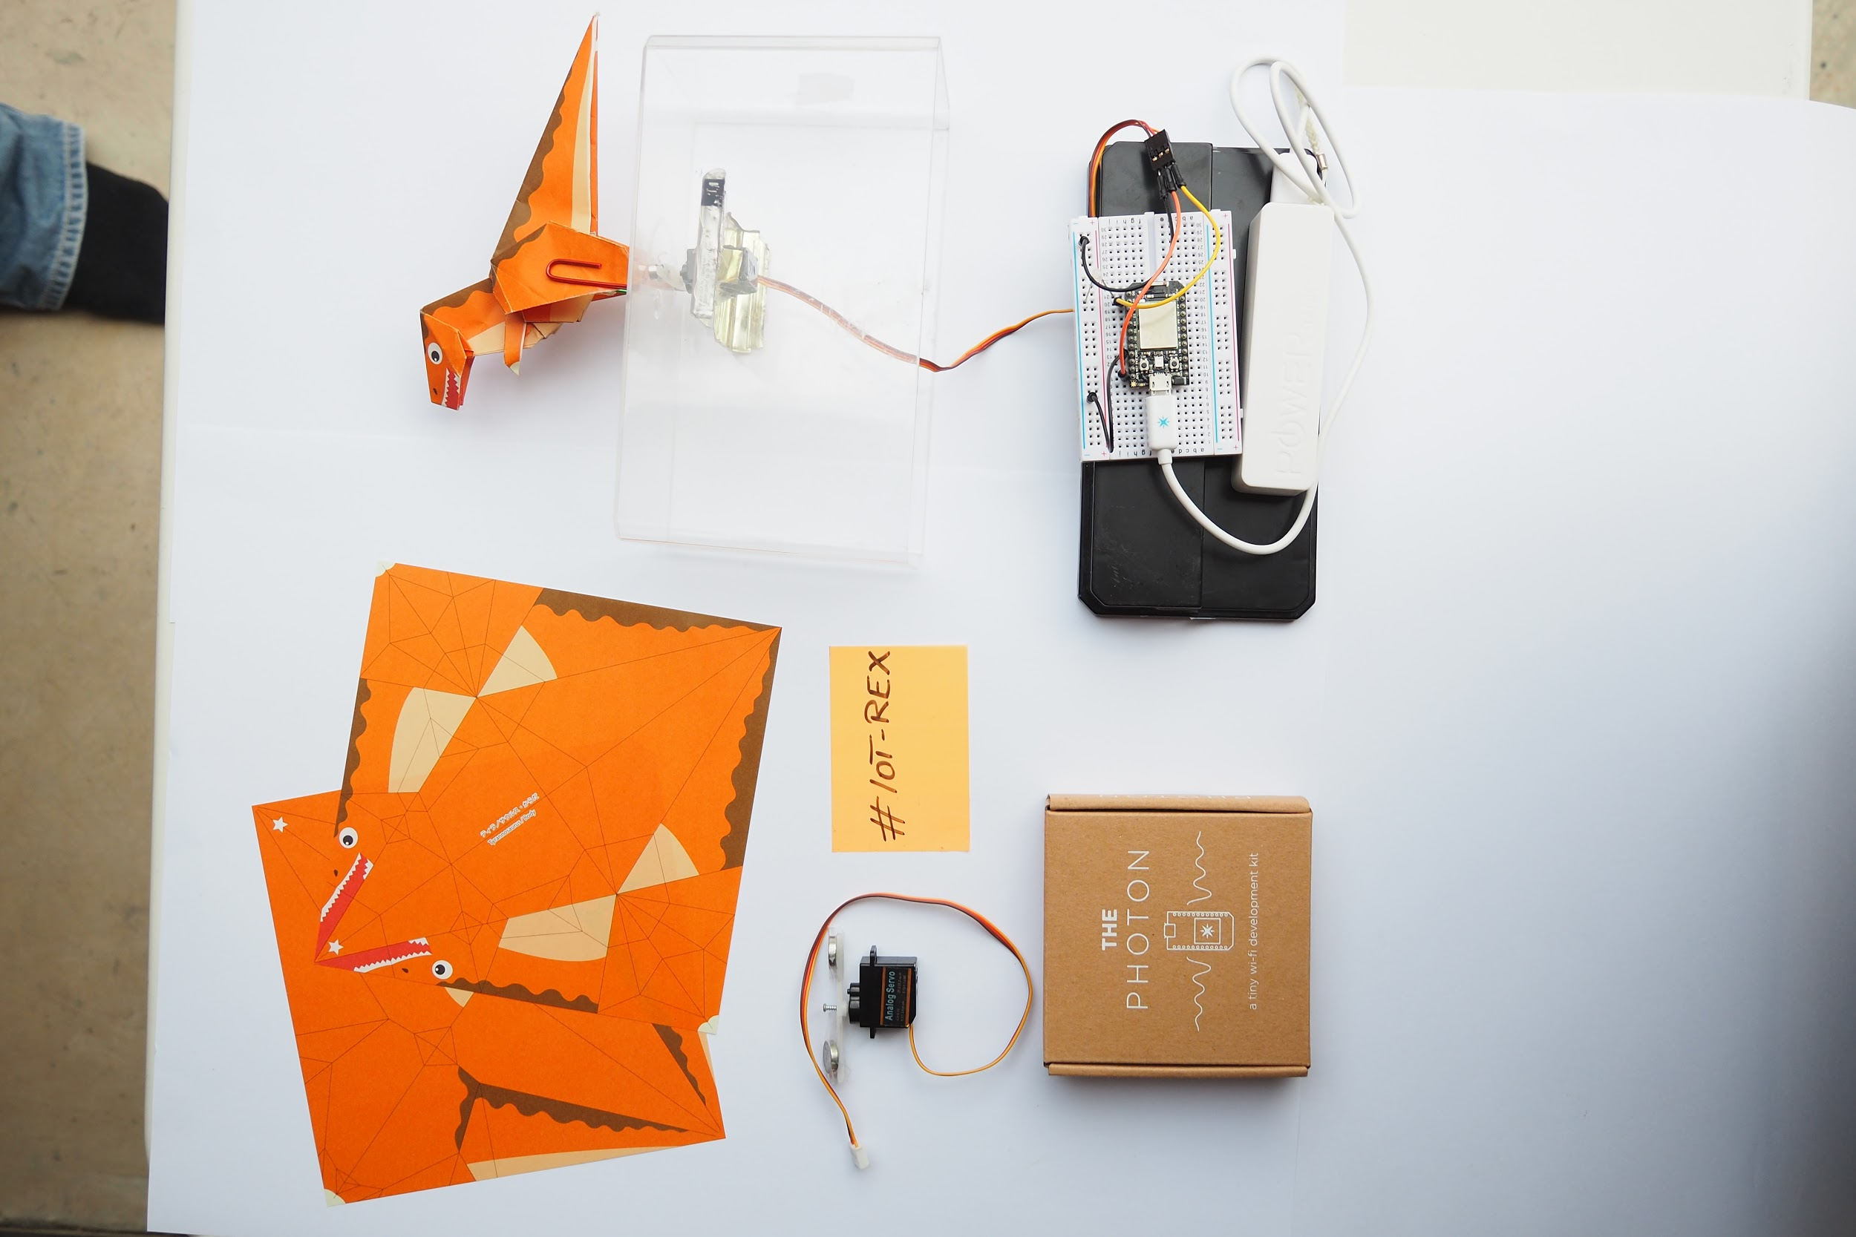
Let’s take a look inside
Back to scary code

Slide 17

MOAR

Slide 18


#IoT devices

Slide 19


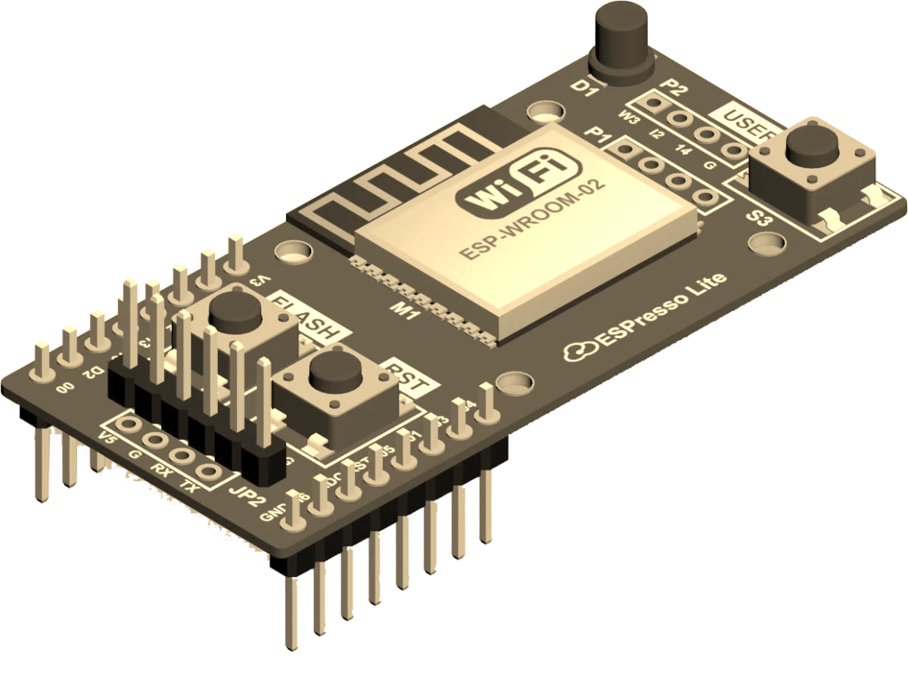
MOAR

Slide 20
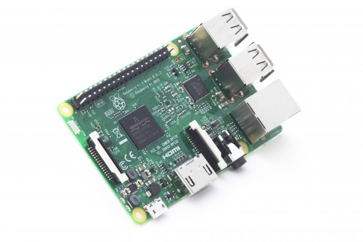
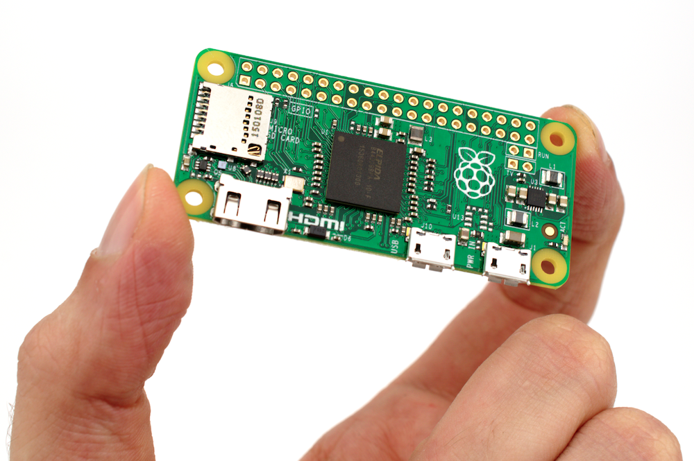
some RaspberryPi

Slide 21



Slide 22
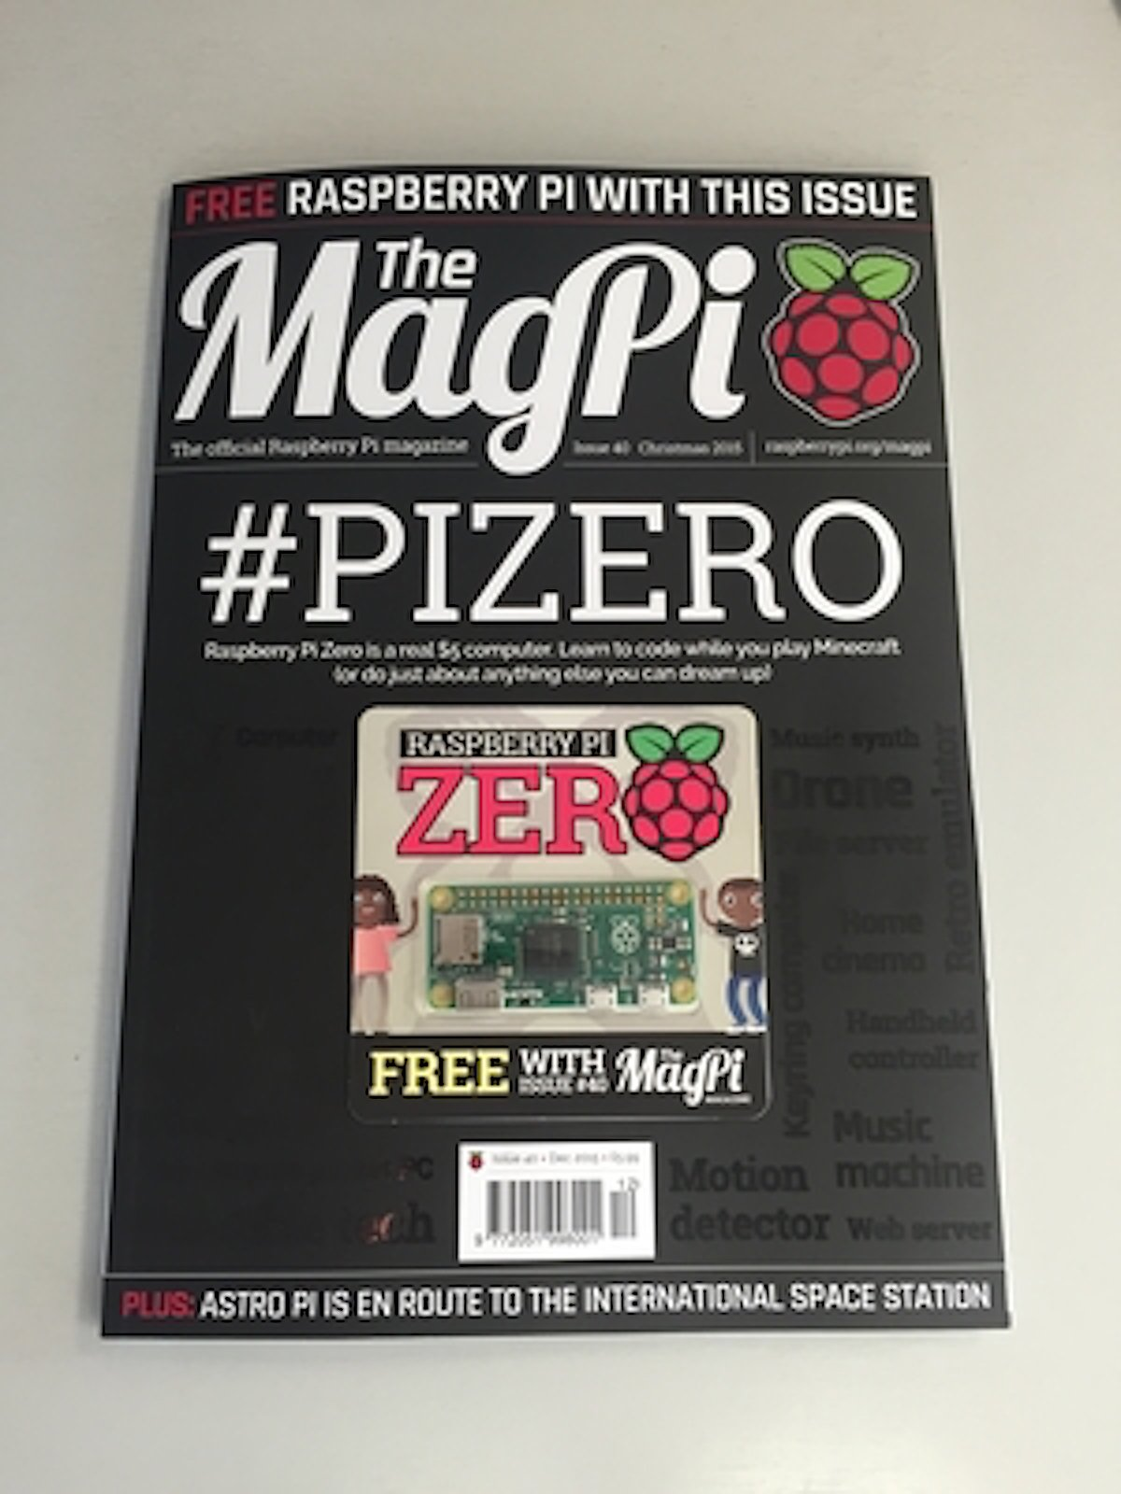
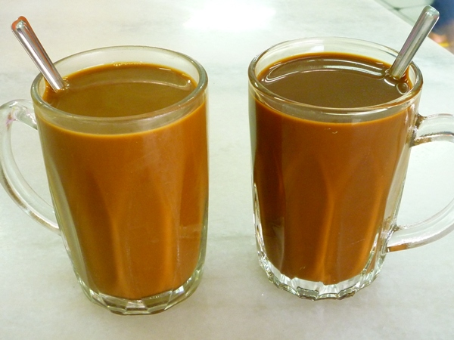

Slide 23
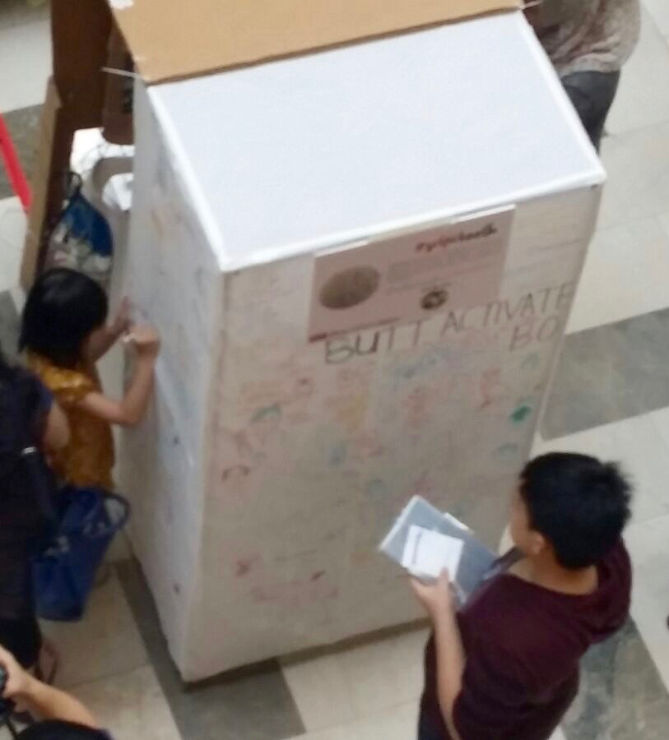
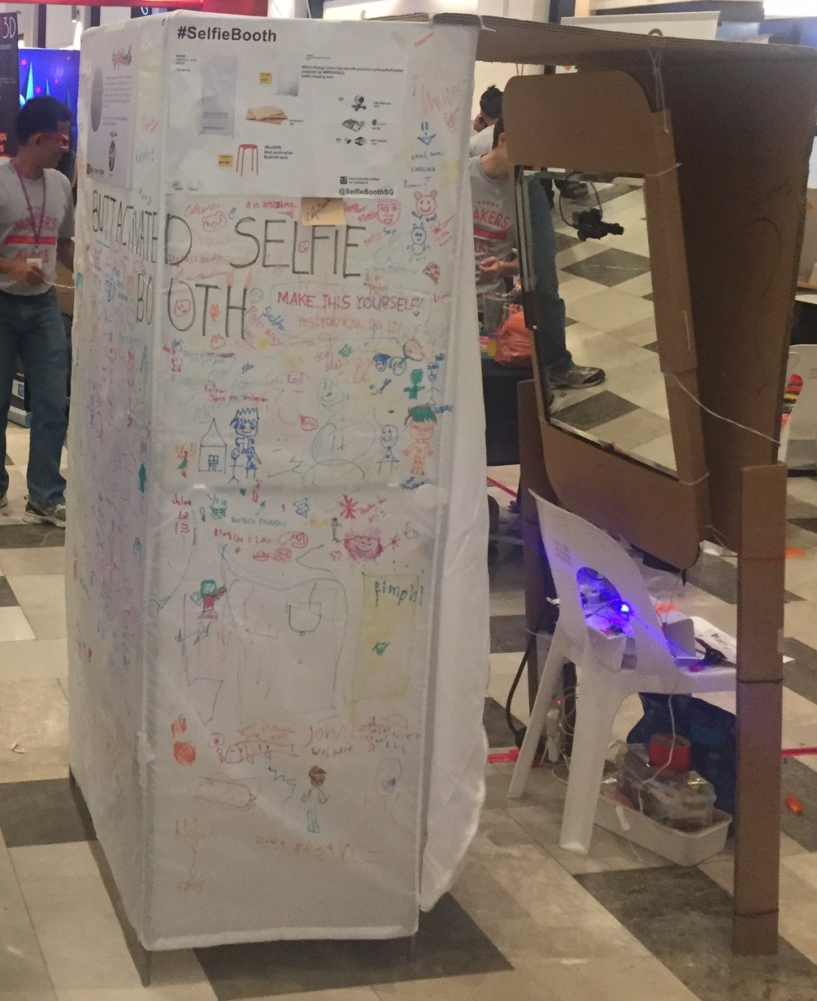
Got MOAR?

Slide 24


Slide 25

#KthxBYE
saad@tusi.sg @saadCaffeine
BTW: #ChangeClimateChange

